Slide 1



Developing Test Specifications Through a Model-Driven Approach
Developing Test Specifications
Through Model-Driven Approach
Irv Badr
Senior Manager of Product Marketing
Notes:
Telelogic Main Title page
Please always use this background graphic with the large Telelogic logo as is for your main Title page.
Fonts used:
Presentation Title: Arial Bold 32 pt, white
Presenter Name: Arial Bold 22 pt, white
Both Presentation Title and Presenter Name (or Subtitle) need to be initial capitalized for every word except prepositions, and centered under the large Telelogic logo.
Avoid adding other logos or imagery.
This image and layout on this page should be copied and pasted onto your presentation as it is different than the master slide template. You can omit the regular background template from the master slide though the Format/Background tool.

Slide 2
Program
Impact of MDD – overwhelmingly positive!
Which type of Test is relevant ?
Introducing Model Driven Development and MDD Testing
Model-based Test approaches
  UML Test Profile (U2TP)
  Support from Modeling Tools
Conventional Testing Approaches – Implementation issues
  Test Specification Languages vs. other Implementation Languages
MDD in Testing for the mass Market – The Future
Tool Demo
  A hands-on example of Model Driven Testing

Slide 3

Quality Control Starts at Inception
Cost to fix defects
1 X
10 X
100 X
1000 X
Analysis
Coding
Testing
Operation
The sooner you find the problem, the cheaper it is to fix

Slide 4
Quality Improvement by Users
Major telecommunications handset maker:
“Model Driven Development reduced the design errors in our application by 64%. We found 97% of all errors during the Coding and Unit Test phase of our project.”
Major telecommunications infrastructure provider:
  90% of coding errors removed
  30-50% of logical errors removed

Slide 5
Few Types of Testing
Conformance
Configuration
Performance
Robustness
Functional
Reliability
Scalability
Unit
Development
Interface
Interoperability
Compatibility
Stress
Integration
Load
Fault tolerance
Degraded mode
Product
Design
System

Slide 6
Basics of Modeling

Slide 7


Model-Driven Development
Diagrams
Requirements
Tests
Model
Code
Documentation
Notes:
A single repository is used to ensure that all information is consistent. The repository adheres to the UML 2.0 specification.

Slide 8
Model-based Testing
Tests should be modeled together with the system architecture and functionality
  systems and their tests tie in with the same system requirements
  changes to requirements affect both system and tests
  systems and tests are made consistent and coherent
Automatically generate the information that is necessary to execute the tests
System Model
Test Model
UML
code generation
code generation
Source code

Slide 9
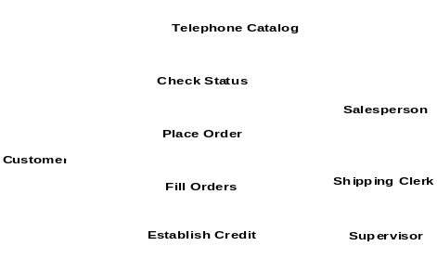
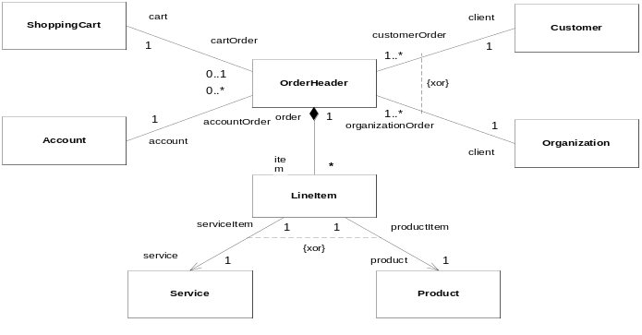
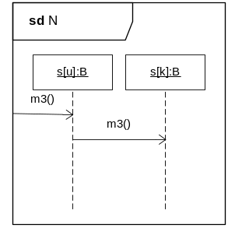
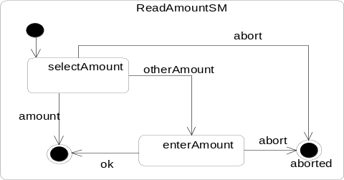
Unified Modeling Language (UML) in a Testing Context
Use Cases
Unit Test
Classes
Testing
System Test
Sequences
States
Integration
Test
From Institute for Informatics, University of Göttingen - Germany
Notes:
alles auf deutsch!!!
use case kasten geht rüber
integrationstest weiter nach rechts, alles zentrieren
siehe auch impl
auf diese und naechste UML folie nur kurz eingehen als motivation
uml folien zeit sparen, viel kürzer
auf uml diags nicht im detail eingehen
UML: Unified Modeling Language
UML for OO projects, analysis, design, documentation.
UML helps to analyze, specify, visualize, design, document system models in order to meet their requirements.
designers using UML for system modelling
only for system design, but no means for test development
OO-SW-Development

Slide 10
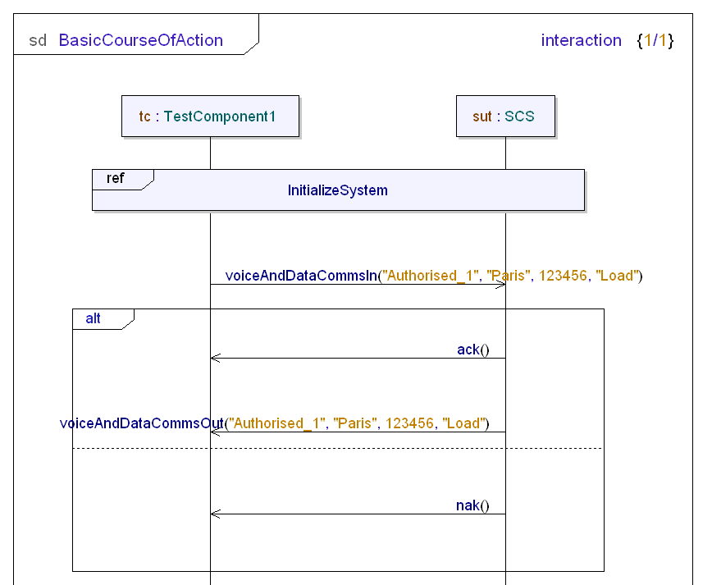
A Common Testing Framework
When modeling, we need a standard method to express tests, which
  works with models at different levels of abstraction
  supports source code
  can be mapped to existing
  testing frameworks
test component
system under test
Enter the UML Testing Profile (U2TP)
  OMG standard
  Implemented in TAU

Slide 11
Implementing Test Cases

Slide 12
Conventional Test Implementation
Conventional programming or scripting languages:
  Rich typing including native list types and support for sub-typing
  Embodies powerful build-in matching mechanism
  Snapshot semantics, i.e., well defined handling of port and timeout queues during their access
  Concept of verdicts and a verdict resolution mechanism
  Support for specification of concurrent test behaviour
  Support for timers
  Allows test configuration at run-time
  Tests focus only on implementation to be tested
Test tool or vendor proprietary testing language:
  Not tied to a particular application or its interface(s)
  No specific test execution environment, compiler or OS

Slide 13
Test Specification Language - Example TTCN-3
Dynamic concurrent testing configurations
Various communication mechanisms (synch and asynch)
Data and signature templates with powerful matching mechanisms
Specification of encoding information
Display and user-defined attributes
Test suite parameterization
Test case control and selection mechanisms
Assignment and handling of test verdicts
Harmonized with ASN.1
Different presentation formats
Well-defined syntax, static semantics and operational semantics

Slide 14
TTCN-3: Example Core (Text) Format
testcase TC_resolveEtsiWww() runs on DnsClient
{
timer t_ack;
serverPort.send(m_dnsQuestion("www.etsi.org"));
t_ack.start(1.0);
alt {
[] serverPort.receive(mw_dnsAnswer("172.26.1.17")) {
setverdict (pass);
}
[] serverPort.receive { // any other message
setverdict(fail);
}
[] t_ack.timeout {
setverdict(inconc);
}
}
t_ack.stop;
}

Slide 15
TTCN-3: Example Graphical Format
Similar in format to U2TP
testcase TC_resolveEtsiWww()
runs on DnsClient
mtc
serverPort
DnsClient
DnsPort
timer t_ack
t_ack
m_dnsQuestion("www.etsi.org")
alt
mw_dnsAnswer("172.26.1.17")
pass
fail
?
t_ack
inconc
t_ack

Slide 16
Roadmap to Fully Model-Driven Testing

Slide 17
UML-Based Test Specification
UML
map
Sequence, Activity,
and Interaction Overview
Diagram
Class Diagram
WSDL
map
map
IDL
ASN.1
MSC
●●●
CORBA
use
generate
TTCN-3
Data
TTCN-3
Behavior
From Institute for Informatics, University of Göttingen - Germany
Notes:
UML Diags auf UML Seq- und Klassdiags abbilden
Verwendung von IDL ermoeglicht zusaetzliche Verwendung fuer z.B. WSDL und CORBA
ooTTCN-3: OO wurde in TTCN-3 bei Arbeit an Abbildungen vermisst
IDL motivation: Black-Box Testen -> Schnittstellen wichtig!
nicht zuviel reden
MSC mächtigkeit nicht so wichtig, aber es war absehbar, dass in UML2 MSC als Ersatz für SeqDiags eingeführt wird
asn.1 nicht erwähnen!
UMl noch detaillierter aufteilen und seq und klass diags hervorheben???
highlighten wo ich bin!?
keine code beispiele

Slide 18
An Agile MDD approach
Requirements
Document
Development
Requirements
Capture &
Analysis
Testing
System
(validation)
Testing
Accept
Increment
Integration &
Regression
Testing
Define
Increment
Unit test
Increment
Architect &
Design
Increment
Build
Increment
Operational
System
= Feedback trace

Slide 19
Tool Demonstration

Slide 20
Testing Resources
Contact:
  Irv Badr
  Irv.badr@telelogic.com
Useful websites:
  www.ttcn-3.org: ETSI’s official TTCN-3 web site
  www.itu.int: TTCN, ASN.1 SDL, MSC standards on-line
  www.telelogic.com : TTCN-3 Development Tools and Traininig
Read publications
  www.telelogic.com : Testing White Papers
  Proceedings of Conference for Testing of Communicating Systems (TESTCOM)
  Presentations of yearly TTCN-3 User Conferences
  in Europe or Asia (see www.ttcn-3.org)
  Get a text book http://www.wiley.com/legacy/wileychi/ttcn-3/
Register for the next TTCN-3 user conference!

Slide 21
What Do You Think?
Question and Answer

